Slide 1
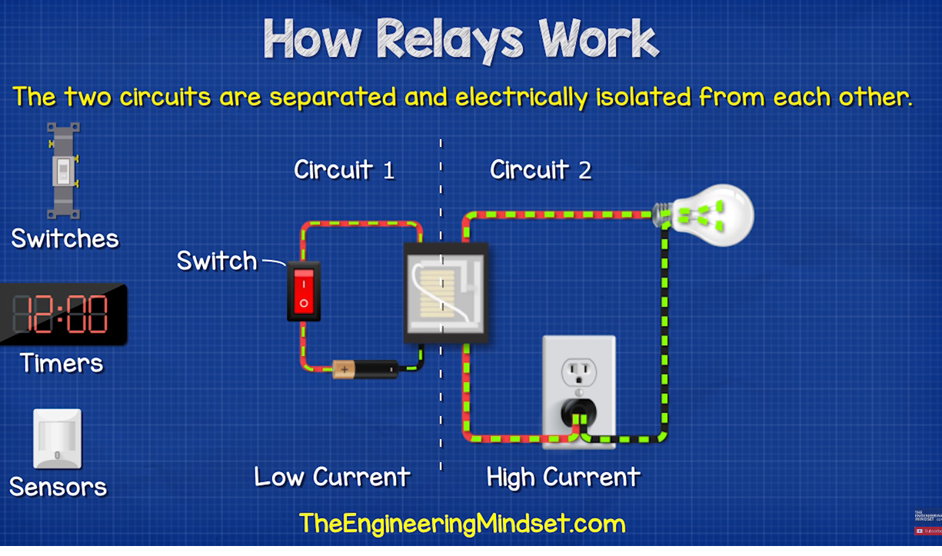
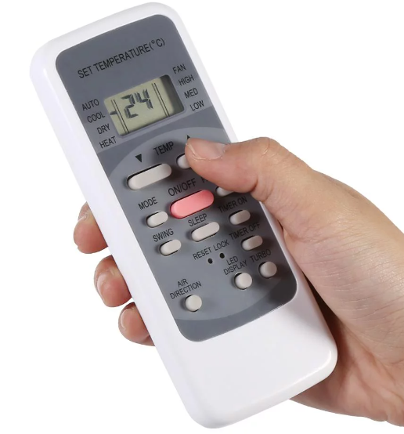
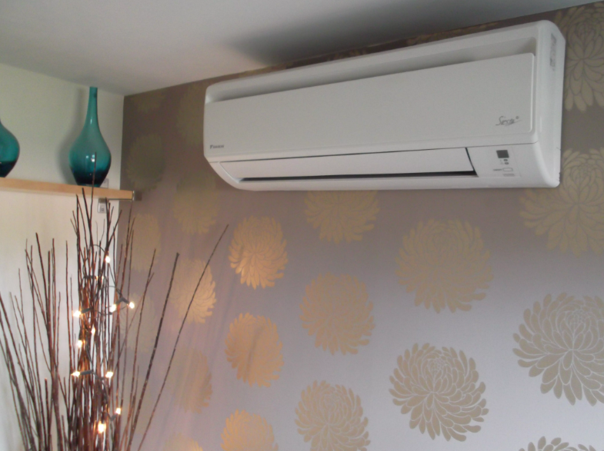
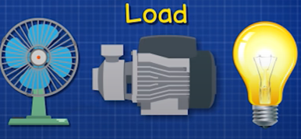

Slide 2
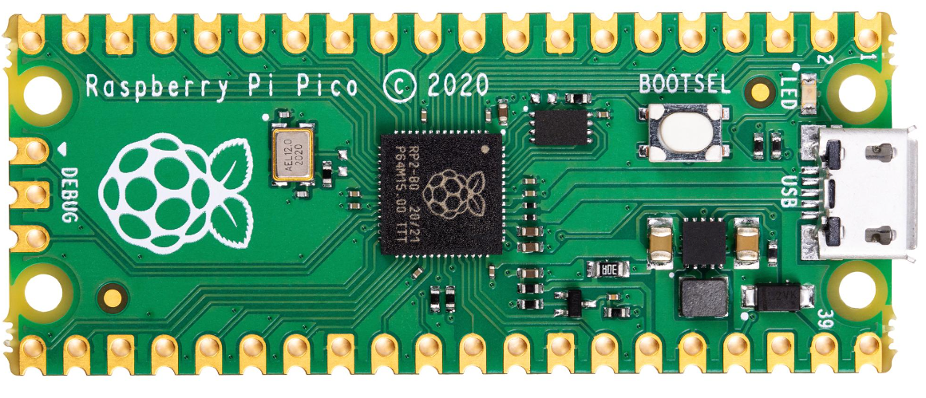
RELAY

Slide 3
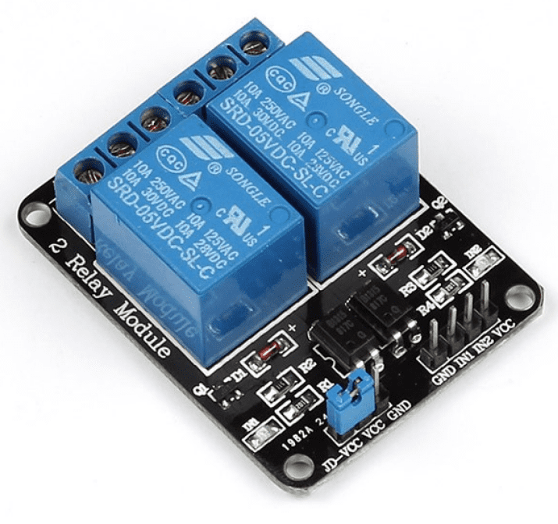
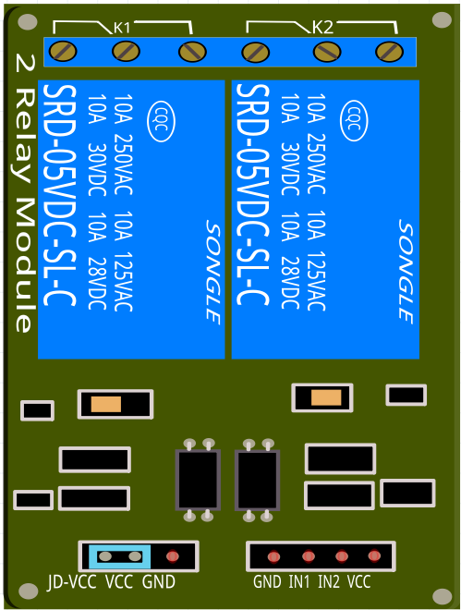


2 Channel 5V Relay
HIGH CURRENT END
IN1
IN2
LOW CURRENT END

Slide 4
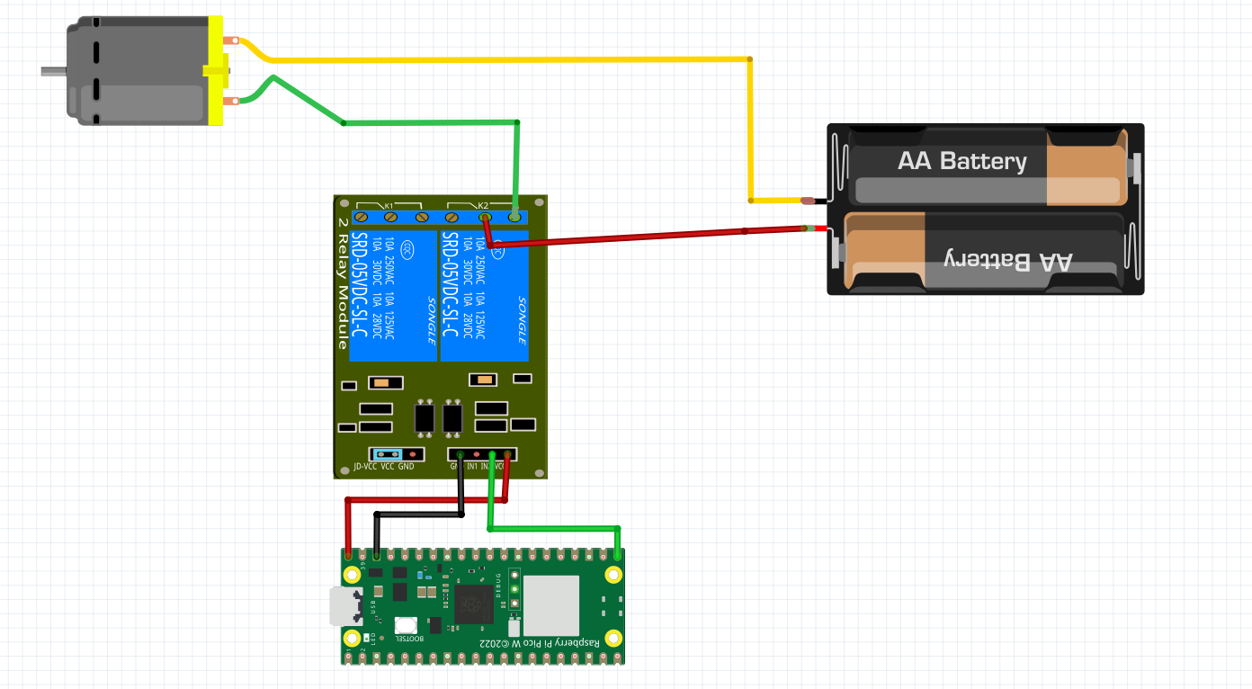
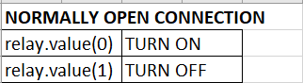
NORMALLY OPEN
CO2
NO2
+ve
-ve
IN1
IN2
IN1
IN2
VBUS
IN2 ->Pin16

Slide 5
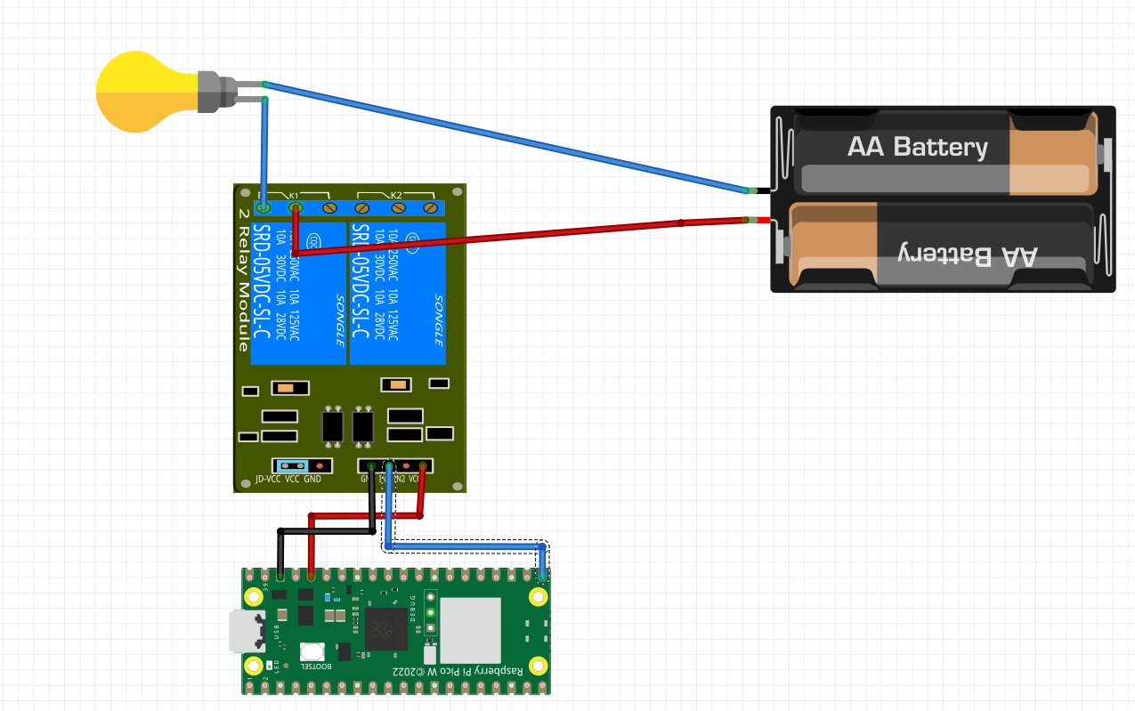
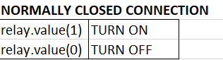
NORMALLY CLOSED
CO1
+ve
NC1
-ve
IN1
IN2
IN1
IN2
V3.3
IN1 -> Pin16

Slide 6
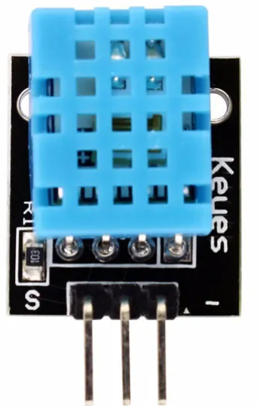
EX 8A - USING DHT11 MEASUREMENT TO TRIGGER AIRCONDITIONER
CO2
NO2
+ve
NORMALLY OPEN
-ve
IN1
IN2
VBUS
IN2 ->Pin16
Pin 14
GND
3.3v

Slide 7
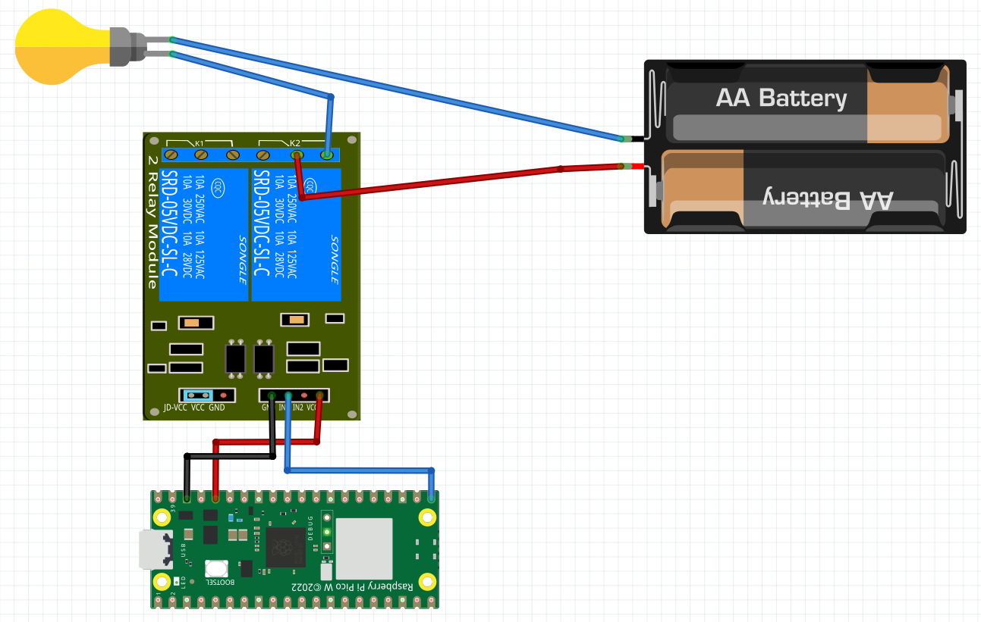
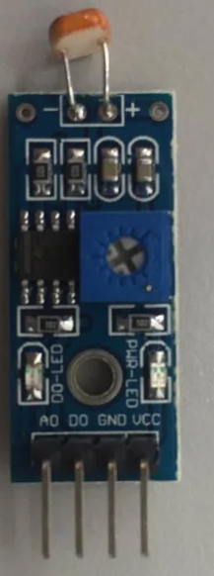
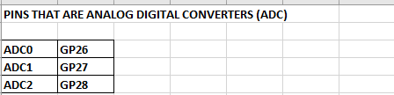
EX 8B – USING A LIGHT SENSOR TO TURN ON STREET LAMPS
CO2
NO2
+ve
-ve
IN2
VBUS
VCC -> VBUS
GND->GROUND
DO -> Pin 17
AO -> Pin 28
IN2 ->Pin16

Slide 8
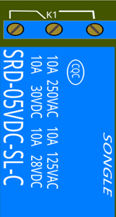
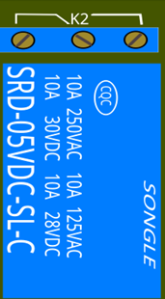
NC1
NO1
NC2
NO2
CO1
CO2
IN1
IN2

